Slide 1
Statistics

Slide 2
Day 1 (Tuesday)
Probability
Probability Distributions
Day 2 (Thursday)
Some Probability Review
Statistics Concepts
Statistical Inference
Regression, Classification, Evaluation
Data Science Immersive

Slide 3
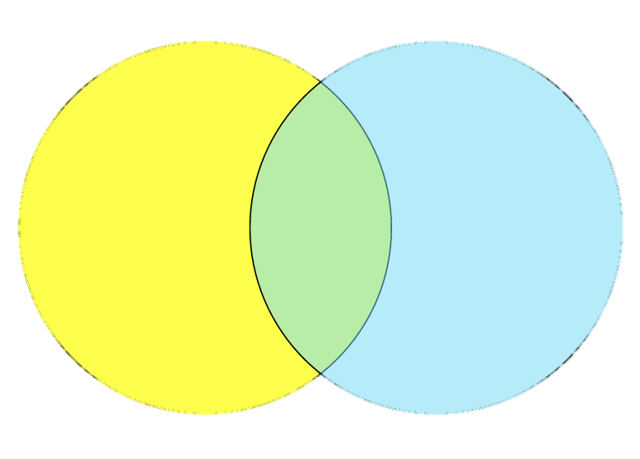

"Review"
$P\left(A and B\right)=P\left(A\right)P\left(B | A\right)$
$P\left(A or B\right)=P\left(A\right)+P\left(B\right)−P\left(A and B\right)$
Bayes Theorem: $P\left(A | B\right)=\frac{P\left(B | A\right)P\left(A\right)}{P\left(B\right)}$
odd
> 3
Notes:
P(A and B) = P(A) * P(B|A)
P(A or B) = P(A) + P(B) – P(A and B)

Slide 4
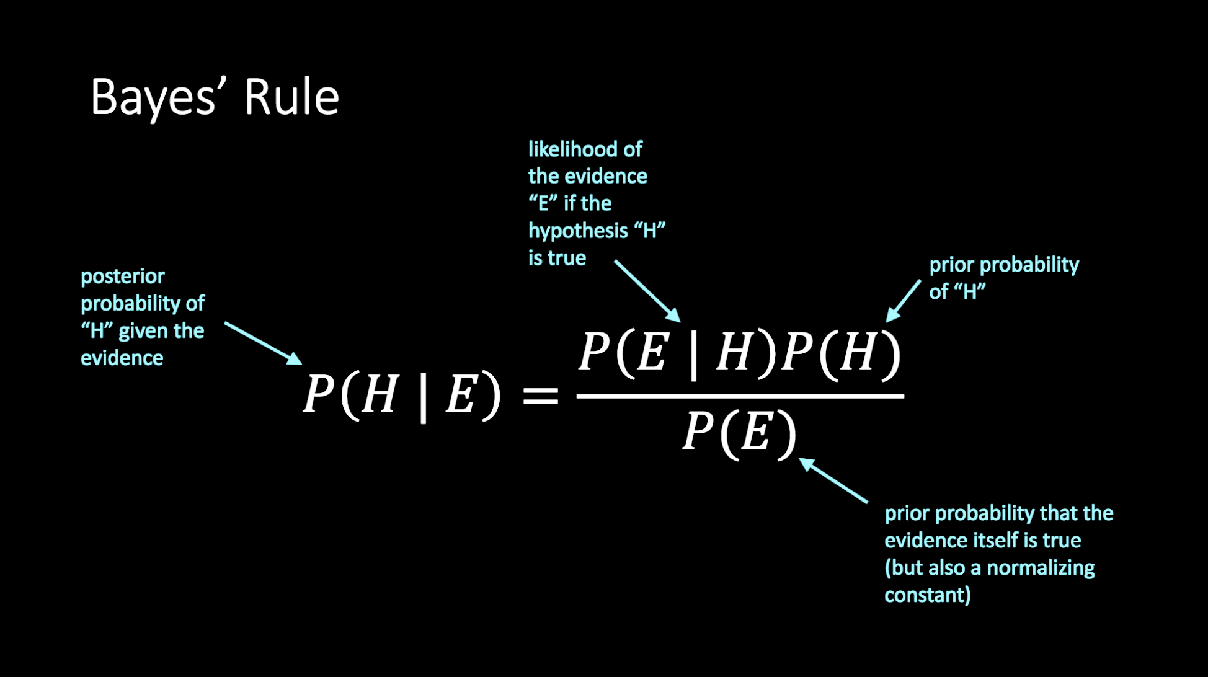
Bayesian Inference

Slide 5
You have two coins and pick one at random. One is fair (50-50 heads-tails) the other is biased (75-25 heads-tails). You flip it three times and it comes up heads all three times. Which coin do you think you have? (no math)
Question 1:

Slide 6


You have two coins and pick one at random. One is fair (50-50 heads-tails) the other is biased (75-25 heads-tails). You flip it three times and it comes up heads all three times. Which coin do you think you have? Part 1: What is the probability you have the biased coin?
Question 1:
$$P\left(biased | HHH\right)=\frac{P\left(HHH | biased\right)P\left(biased\right)}{P\left(HHH\right)}$$
$$=\frac{\left(.422\right)(.5)}{\left(.273\right)}=.77$$

Slide 7




You have two coins and pick one at random. One is fair (50-50 heads-tails) the other is biased (75-25 heads-tails). You flip it three times and it comes up heads all three times. Which coin do you think you have? Part 1 (cont): Which coin do you think you have?
Question 1:
$$P\left(biased | HHH\right)$$
$$P\left(fair | HHH\right)$$
$$=\frac{\left(.422\right)(.5)}{\left(.273\right)}=.77$$
$$=\frac{\left(.125\right)(.5)}{\left(.273\right)}=.23$$

Slide 8


You have two coins and pick one at random. One is fair (50-50 heads-tails) the other is biased (75-25 heads-tails). You flip it three times and it comes up heads all three times. Which coin do you think you have? Part 2: How would your answer change if you started with a bin of 1000 coins, only one of which is biased?
Question 1:
$$P\left(biased | HHH\right)$$
$$P\left(fair | HHH\right)$$
$$=\frac{\left(.422\right)(.001)}{\left(.1253\right)}=.003$$
$$=\frac{\left(.125\right)(.999)}{\left(.1253\right)}=.997$$

Slide 9


Example: Document classification
We want to classify New York Times articles into sports and fashion.
We can only see a single word and it's "coach".
$$P\left(sports | "coach"\right)=\frac{P\left("coach" | sports\right)P\left(sports\right)}{P\left("coach"\right)}$$
$$P\left(fashion | "coach"\right)=\frac{P\left("coach" | fashion\right)P\left(fashion\right)}{P\left("coach"\right)}$$

Slide 10

Example: Document classification
What if we were classifying articles from Vogue instead of NYT?
$$P\left(sports | "coach"\right)=\frac{P\left("coach" | sports\right)P\left(sports\right)}{P\left("coach"\right)}$$

Slide 11
Distributions

Slide 12
Some Vocab
Random Variable
Not a variable in the traditional sense, can even be more like a function, or a shorthand.
We roll seven dice
What is the probability that the sum of the upward faces is greater than 30?
What is the probability that the sum of the upward faces is even?
What is the probability that the sum of the upward faces is divisible by 7?
We say X is a random variable: X = the sum of the upward faces of 7 dice.
What is P(X > 30)?
What is P(X is even)?
What is P(X % 7 = 0)?

Slide 13
Some More Vocab
Probability Mass Function: P(X = x) = …
Probability Density Function: f(X = x) = …

Slide 14
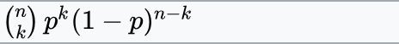
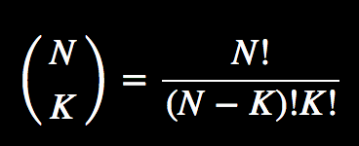
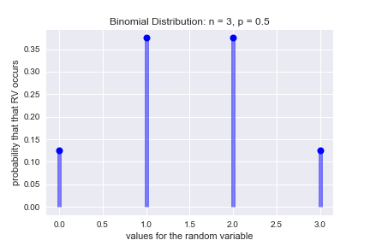
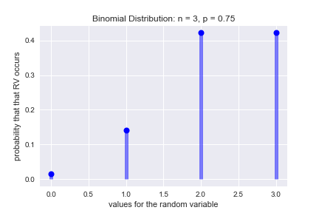
Binomial Distribution

Slide 15
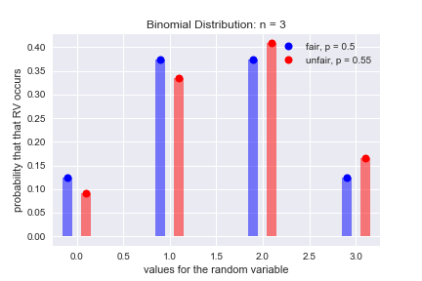
Binomial Distribution

Slide 16
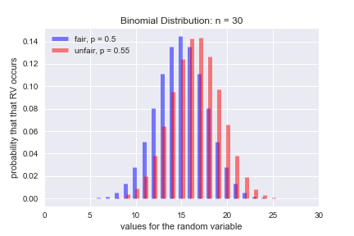
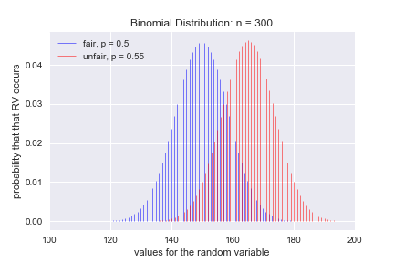
Binomial Distribution

Slide 17
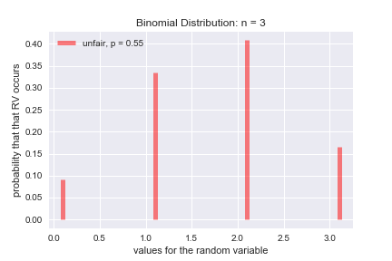
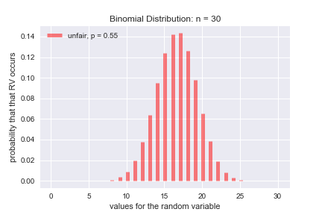
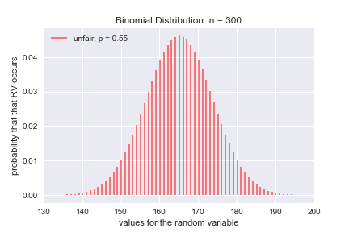
Today: What is the probability that our random variable is up to __?

Slide 18
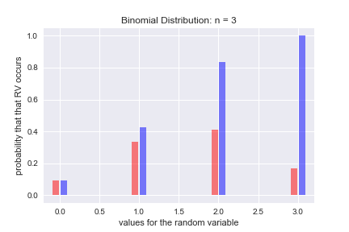
Today: What is the probability that our random variable is up to __?

Slide 19
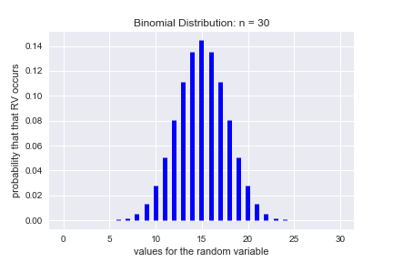
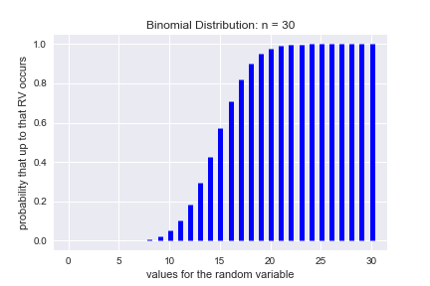
Binomial Distribution
two parameters, n and p
n is the times you're flipping the coin
p is the probability of success on each flip

Slide 20

Poisson Distribution
The Poisson distribution is a discrete probability distribution that expresses the probability of a given number of events occurring in a fixed interval of time or space if these events occur with a known constant rate and independently of the time since the last event. (thank you Wikipedia)
$E\left(X\right)=λ$
$P\left(X=k\right)=\frac{λ^{k}e^{−k}}{k!}$ (e = 2.71828182 )
$P\left(X<k\right)= e^{−λ}\sum_{i=0}^{k}{\frac{λ^{i}}{i!}}$
Notes:
{\displaystyle e^{-\lambda }\sum _{i=0}^{\lfloor k\rfloor }{\frac {\lambda ^{i}}{i!}}\ }

Slide 21
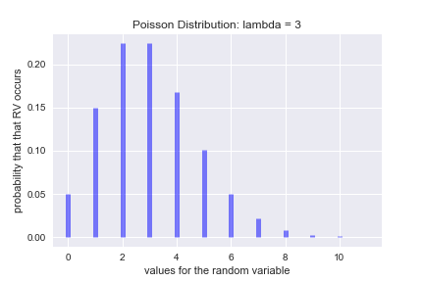
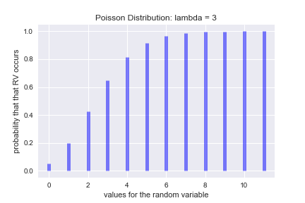
Also Poisson Distribution

Slide 22
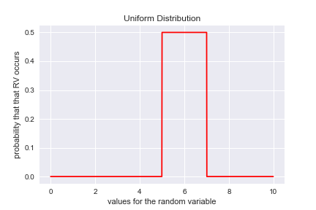
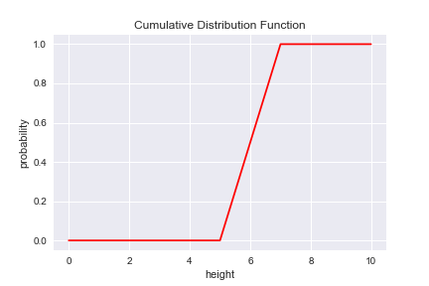
Also Uniform Distribution

Slide 23
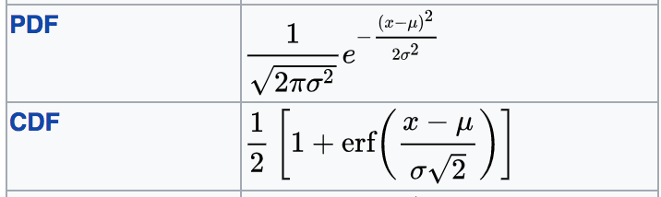
Normal Distribution
Super common everywhere
Parameter:
mu, the average
sigma, the standard deviation
(variance, sigma squared)
PDF and CDF are really messy, so use a lookup table or a computer.

Slide 24
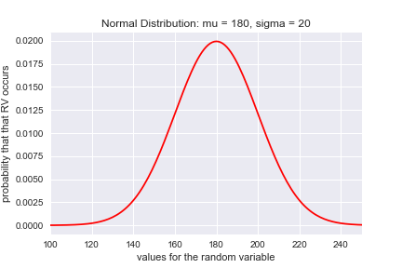
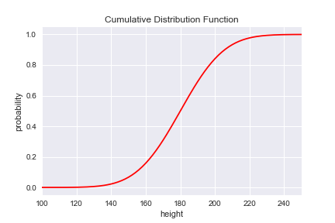
Also Gaussian (Normal) Distribution

Slide 25
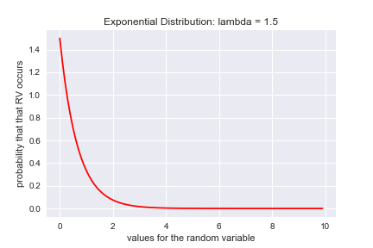
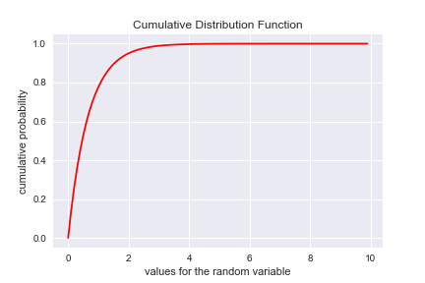
Exponential Distribution
Think of exponential decay
Probability density function: f(X=x) = λ e^{−λx}
Cumulative density function: f(X<x) = 1 − e^{−λx}
Parameter: lambda, inverse of the expected value (aka half life)

Slide 26
EXAMPLE PROBLEMS
Determine the distribution
Write down the parameters and random variable
Substitute and solve!

Slide 27
HYPOTHESIS TESTING

Slide 28
HYPOTHESIS TESTING
STATE THE HYPOTHESIS: H₀ and H_{A}, must be mutually exclusive
FORMULATE AN ANALYSIS PLAN: how you'll evaluate H₀, usually a single test statistic
ANALYZE SAMPLE DATA: find the value of the test statistic
INTERPRET RESULTS: reject or fail to reject the H₀

Slide 29
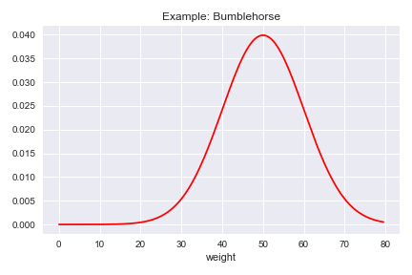
Types of Errors
Type 1
False Positive
Type 2
False Negative

Slide 31
Regression, Classification, Evaluation

Slide 32
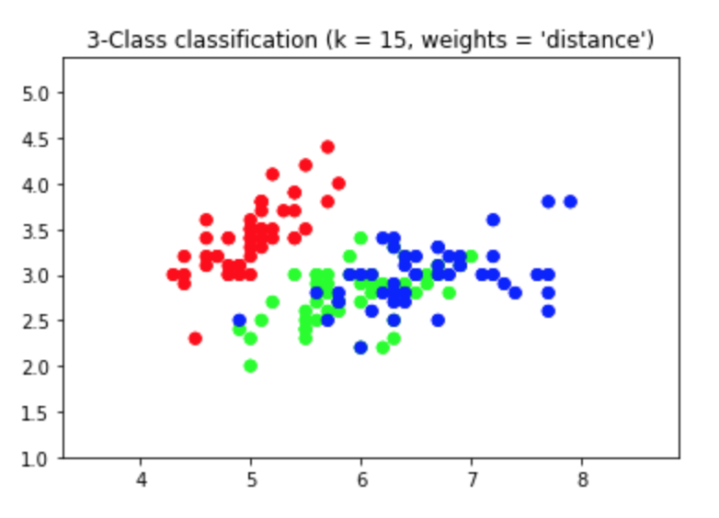
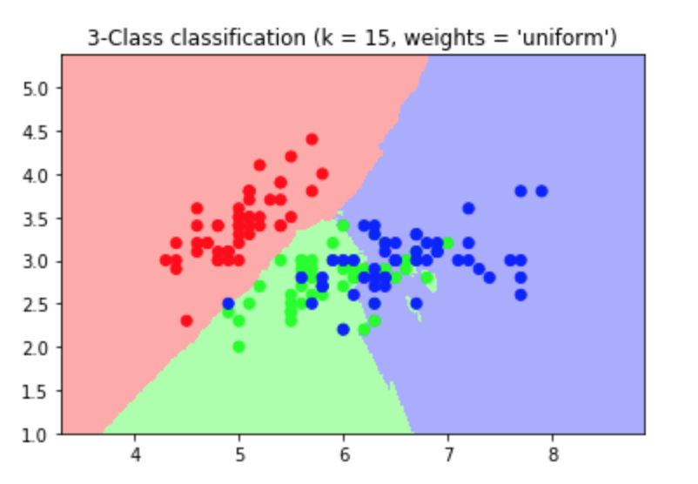
Supervised vs Unsupervised Learning

Slide 33
Supervised vs Unsupervised Learning

Slide 34
Vocabulary
Two Types of Supervised Learning
Regression
predicting a continuous value
(height, weight, time)
Classification
predicting a category
(fraud/not fraud, churn/not churn, British/French/German)

Slide 35
Vocabulary
Features (aka Covariates, Independent Variables, or Regressors)
What you use to make your prediction
Targets (aka Outcome, Dependent or Endogenous Variable)
The predictions

Slide 36
Confusion Matrix

Slide 37
(questions)

Slide 38

If We Have Time And Energy http://blog.minitab.com/blog/michelle-paret/explaining-the-central-limit-theorem-with-bunnies-and-dragons-v2
Notes:
https://vimeo.com/75089338

Slide 39
Data Science Immersive

